Slide 1
Sharing research findings School exclusions and mental health
Sarah Martin-Denham (sarah.denham@sunderland.ac.uk)
Presentation to Department for Education
30 November, 2020

Slide 2
Profile
Senior Lecturer and Researcher
Programme Leader and Tutor NASENCO
Author for Sage Publishers
Convenor Interdisciplinary Research Network: Adverse Childhood Experiences North East
Chair: Independent SENCO Network
Senior Fellow Higher Education Academy
Vice-Chancellor Teaching Fellow
5 monographs, 4 journal articles, 2 books, 2 policy briefs
1. Introductions

Slide 3
Agenda
1. Introductions
2. Overview of the Together for Children (TfC) research into school exclusions (aims, objectives, sample, methodology)
3. Brief overview of TfC funded research findings and subsequent journal articles
4. Q and A
5. Roundtable discussion of potential of research influence on policy and gaps in evidence base
6. QR funding and future planned publications
7.Future actions and ways forward

Slide 4
Evidence base (sure.sunderland.ac.uk)
¹Martin-Denham, S. (2020a) The enablers and barriers to successful managed moves: The voice of children, caregivers and professionals https://sure.sunderland.ac.uk/id/eprint/11942/
²Martin-Denham, S. (2020b) An investigation into the perceived enablers and barriers to mainstream schooling: The voices of children excluded from school, their caregivers and professionals https://sure.sunderland.ac.uk/id/eprint/11941/
³Martin-Denham, S. (2020c) A review of school exclusion on the mental health, well-being of children and young people in the City of Sunderland https://sure.sunderland.ac.uk/id/eprint/11940/
⁴Martin-Denham, S. and Donaghue, J. (2020) Impact and Measure of Adverse Childhood Experiences, Journal of Public Health https://rdcu.be/b68MO
⁵Martin-Denham, S. (2021) School exclusion, substance misuse and use of weapons: An interpretative phenomenological analysis of interviews with children. (Accepted) Support for Learning.
⁶Martin-Denham, S. (2020) Riding the roller coaster of school exclusion coupled with drug misuse: The lived experience of caregivers. Emotional and Behavioural Difficulties. DOI: 10.1080/13632752.2020.1848985
⁷Martin-Denham, S. and Donaghue, J. (2020) Out of sight, out of mind? Managed moves in England. Sunderland: University of Sunderland. https://sure.sunderland.ac.uk/id/eprint/11883/
⁸Martin-Denham, S. and Donaghue, J. (2020) Excluded for no real reason. Sunderland: University of Sunderland. https://sure.sunderland.ac.uk/id/eprint/11472/
⁹Martin-Denham, S. (2021) The road to school exclusion: An interpretative phenomenological analysis of interviews with parents of children with autism in the UK. (In review ‘Autism’)

Slide 5
Agenda items 2-3 Overview of the exclusions research (aims, objectives, sample, methods) Overview research findings and subsequent journal articles
Exclusions research Sunderland: Funded by Together for Children^{1,2,3,5,6}

Slide 6
Aims and objectives
Aim: To investigate the factors that impact upon social and emotional wellbeing of children and young people from 3-16 years in Sunderland which may lead to exclusion from school.
Key objectives:
To elicit the perceptions and experiences of excluded children, their caregivers and professionals of the barriers and enablers to mainstream schooling
To determine if it is possible for children at risk of school exclusion to feel and be included while attending mainstream school
To establish the impact of school exclusion on the child and family
To determine the drivers for school exclusion

Slide 7
Sample: Participant overview
Group | Count | Sample
Children | 55 | 32%
KS1 | 20 | 11%
KS2/3 | 15 | 9%
KS4 | 20 | 11%
Caregivers | 41 | 24%
KS1 | 4 | 2%
KS2/3 | 16 | 9%
KS4 | 21 | 12%
Professionals | 78 | 45%
Nursery headteachers | 4 | 2%
Primary headteachers | 28 | 16%
Secondary headteachers | 9 | 5%
Specialist headteachers | 4 | 2%
ARP/AP headteachers | 10 | 6%
SENCO | 14 | 8%
Health and support | 9 | 5%
Total | 174
174 children, caregivers and professionals interviewed. In addition, there were three advisory groups, 12 children, five professionals from health/support services and five education professionals.
This is the most substantial piece of primary research carried out to date on the enablers and barriers to mainstream schooling for those at risk of school exclusion in England.

Slide 8
Proportion of Sunderland schools interviewed
Type of School | Total in Sunderland | Sample Candidates | % Sampled
Mainstream Nursery | 8 | 4 | 50%
Mainstream Primary | 62 | 28 | 45%
Mainstream Secondary | 18 | 10 | 56%
Special School | 7 | 4 | 57%
Alternative Provision | 6 | 4 | 67%
Additional Resourced Provision | 15 | 3 | 20%
Total | 116 | 53 | 46%

Slide 9
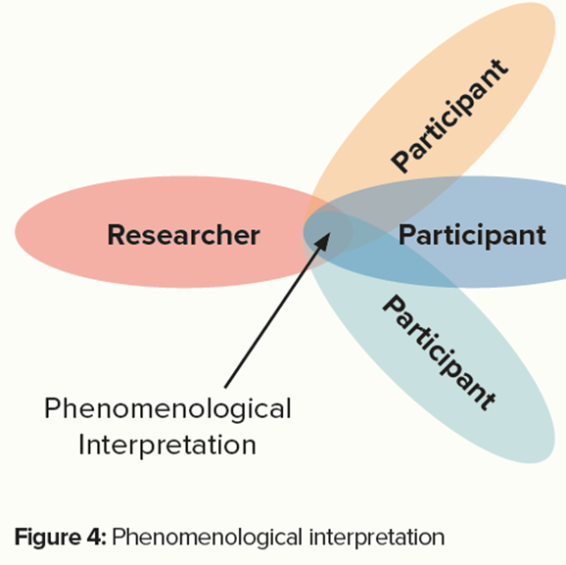
Methodology
Mixed methods including content (interpreting and understanding) and interpretative phenomenological analysis (IPA) (Smith and Osborn, 2015).
The interviews were suitable for IPA as they included rich detail with novel stories and language (Riley et al., 2017; Spiers et al., 2017; Spiers and Riley, 2019; Smith et al., 2009)
A two-stage process or double hermeneutic was used, where the participant makes sense of their world and the researcher, in an active role, attempts to authentically make sense of their experiences (Colaizzi, 1978; Giorgi, 1985; Smith and Eatough,2007; van Manen, 2014 (Harding, 2019)

Slide 10
What are the factors associated with teacher and pupil wellbeing, and what interventions and approaches are effective in supporting and promoting wellbeing of all in schools and colleges? What types of approaches lead to better outcomes for condition-specific learning needs in mainstream schooling? How can schools best identify children's mild to moderate mental health needs, and what role can early intervention play in preventing escalation? How might the interruption to learning affect behaviour and attendance over the longer term? What are the lessons for reintegration? DfE (2018, 2020) Areas of research interest

Slide 11
Children: Challenges in mainstream school² (KS1)
The environment
The curriculum
‘I need help in the playground because me and a child had a problem’
‘Noise made me feel pressure, I was upset and angry’
‘Sometimes I do scream that’s how I stop hurting people’
‘I find it difficult to do maths'
‘Cause I don’t really like maths’
‘I hate the mud’
‘I find it difficult because the work is too hard’
‘I find it hard when I am doing PE, sometimes punch people because everyone is shouting and chanting it makes me angry (PE)’

Slide 12
Children: Challenges in mainstream school² (KS2-3)
Pressures on teachers
The environment/approaches
‘There were too many people and I needed so much help, I wasn’t getting any at all, I didn’t cope well’
‘I say can you help with this? The person says no I’ll come back to you, but they came back at the end of the lesson or at the end of the task’
‘They didn’t have time to listen’
‘It is hard for the teachers to get round’
‘There were too many people and I needed so much help. I wasn’t getting any, at all. I didn’t cope well. So I would kick off a lot’
‘It stresses me out. I feel I start to go crazy. When I’m angry that I feel like I’m going crazy’
‘The fire alarms there are so high pitched. That’s why I’m glad I’ve left'
‘They would have my arms like ‘that’ and someone was on the other side, pulling my arms’
‘Every time the times tables get quick… I used to get one out of ten and others get ten out of ten, but they were too big and there was a timer, you had to read how many you got in front of the class’

Slide 13
Children: Challenges in mainstream school² (KS4)
Lack of in class support
The environment/approaches
‘They didn’t support me, so I was going home crying… because they weren’t helping me through anything, they just told me to get on with it’
‘The fact is when I asked for help, they wouldn’t give it to me, they would just say I will come back to you’
‘Thirty children and only one member of staff to support them’
‘They can’t get round a class of thirty, just helping one child all the time’
‘He would make us line up on the morning break and dinner to make sure we were all checked’
‘We would be outside for twenty minutes to make sure we had our coats and correct uniform'

Slide 14
Length of time in isolation²
From DfE Behaviour and Discipline (DfE, 2016)
“Schools can adopt a policy which allows disruptive pupils to be placed in an area away from other pupils for a limited period” (42)
“It is for individual schools to decide how long a pupil should be kept in seclusion or isolation, and for the staff member in charge to determine what pupils may and may not do during the time they are there” (43)
'Emotional abuse is any type of abuse that involves the continual emotional mistreatment of a child. It's sometimes called psychological abuse. Emotional abuse can involve deliberately trying to scare, humiliate, isolate or ignore a child' (NSPCC, 2020)

Slide 15
Impact of isolation (children)²
Impact on mental/physical health
Impact on learning
‘I used to pull my hair out, scratch my face. I couldn’t cope with it at all. The teachers used to sit there and watch me cry’
'They used to call it ‘the bridge’ because it made you want to just jump off a bridge’
‘It was depressing I felt alone'
‘I ended up quite lonely’
‘I didn’t like it, it made me feel sick, they just told me to do my work’
‘You weren’t allowed to cough or breathe loud’
‘You weren’t allowed to turn around or make any noises’
‘It made me feel dizzy’.
‘I didn’t do anything. So that is why I came to this school knowing nothing (alternative provision), I was so behind on everything after two and a half years in isolation’
‘I couldn’t even read or write properly, because they used to kick me out of lessons’
‘They just told you to sit down and get on with your work, no teaching’
‘Not taught just worksheets, just had to figure that shit out for myself, but that’s life isn’t it’
‘If I asked them but they wouldn’t help go through a question. They would do an example and then say they wouldn’t help anymore’

Slide 16
Impact of isolation (caregivers)²
'Shoved in a room and not spoken to. That would be for a lot of the time’
'It’s like a prison and they are locked in the room’
'You are basically torturing him. How can you expect him to work when he doesn’t have time to reset himself? When he doesn’t have a break from that room’
‘If you’re going to lock him up in a room well, he’ll just be like a crazed animal’
‘No breaks and not being able to communicate with teachers or peers they don’t get break times, they don’t get lunchtimes. A cold sandwich gets sent from the main school across'
‘A school we know uses the term lockdown for isolation. ‘We’re putting you in lockdown?’ Wow! It’s like come on. What type of word is that? They’ve got no windows in the room where the child goes. Then they panic and just misbehaves again and gets another day added on’
‘They had to sit in silence all day. I don’t agree with isolation, sitting in silence he would come home in a complete mood. Because obviously he had sat there for hours, not being able to speak’

Slide 17
Nursery headteachers: Segregating children²
Reasons for segregating
Responses to behaviour
'Huge temper tantrums… scratching members of staff, biting, kicking, all sorts of things it was appropriate to remove him’
‘For us, it’s very much about having an inclusion policy, not an exclusion policy. We never have time out; we always have time in. If you’re excluded, you will never learn how to behave if you’re not part of the group’
‘When a staff member could read that he was ready enough to come back then they would say ‘would you like a cuddle?’
‘We will come into my room and we’ll sit together and rock until she’s calmed down... At first, I did have to explain to the staff that this isn’t about us rewarding her behaviour; it’s about us supporting her to learn to regulate it. We’ve got that now’

Slide 18
Secondary headteachers: reasons for isolation²
‘If we find that a child is finding it hard to get through the door’ (come into school)
'My assistant head in charge of that area is a bit soft and will say ‘I don’t want to send him home, or he’s a looked after child’ so we sit him in the corridor outside, and say let’s contain him'
‘If children are not behaving to the standards we expect’
‘Say they have had an argument with the teacher or sworn at the teacher then they would be in internal exclusion. Years ago you would have put somebody out for that’
‘We use isolation as an evidence-gathering tool, especially for young people with EHCPs. So they’re saying ‘we can’t manage’ so we’re saying ‘well prove you can’t manage’
‘A lot of students hate being in there, so they will do anything to not be in there. It’s a quiet environment. You sit there on your own in silence; they generally don’t like being in there’
‘We don’t exclude you from breaks and lunchtimes, we are humane (laughs) please make sure that goes into the report. We do set toilet time and we still feed people. The parents are informed and there is no parental consent sought’
‘Isolation is a small boothed room which is not very nice, where they are working quietly with school behavioural managers, some of whom are leaders. They might be in there for the rest of the lesson, the morning, or the day’

Slide 19
Effectiveness of isolation (SENCOs)²
‘As an immediate response when a child is having an episode to get them out of that lesson and get them back into the next one, yes I think that has quite a good effect’
‘When it’s repeating it’s the same children going in the room time after time, there is no learning, no improvement behaviour and no I don’t think it works. They have identified needs not being addressed. It just helps the rest of the cohort move on with their learning. It doesn’t sort the problem out for that particular child’

Slide 20
Health professional views on isolation booths²
Mental health implications
Learning implications
‘You could say that the isolation booths are false imprisonment'
‘what is the impact of isolation on children with regulation needs, isolation is not a reasonable adjustment’
‘The impact of sitting in silence for a day, week, month or year, you just cannot imagine’
‘By stripping children of their dignity you are perpetrating a corrosive culture, it is dehumanising’
‘They can bring work if they want, they don’t have to because they have lost the right to be taught’
‘I cannot understand why isolation is used, what purpose it serves. The quieter environment may help some, but it seems no educational instruction takes place’
‘Why are the children contained on school premises if they have not been taught?’

Slide 21
Children: Keeping us in mainstream²
KS1
KS2/3
'Shorter school days'
'Nurture group'
'Cuddling'
'Having time to talk'
'Help me make good choices'
'To bring in teddies and fidget cubes'
'If someone had explained the work. I would have done it. I'd have understood it'
'If they had given you a list, like a power point. It tells you; you need to this, then this and this'
'I need more staff helping, explaining things, maths was the only lesson I could get because I have dyslexia. They weren't helping with that'
'Maybe not restrain me as much'
'The more they shout, the more I shout'
'Football calms me down when I am with my friends'

Slide 22
Caregivers: What could have prevented the exclusion²?
'They needed to listen. They were very quick to just say he was naughty’
‘Listen to the kids when they get a bit silly in their chairs, they can’t sit still. Now’s the time to take them out, to make them run around the field a couple of times’
‘They need training. They need to understand not just the strategies but how to apply them and go and do a course to understand sometimes their reaction is anxiety’
‘Doctors pushed me back to nursery staff who pushed back at me, I had nowhere to turn’
‘I was told to wait until he was five, he was only three, as soon as he was five, he was permanently excluded’

Slide 23
The managed move model¹
‘The root of the problem was not recognised or supported'
‘To have time to settle and get along with people’
‘To have someone from your last school to go with you that you respect’
‘To start slowly, maybe half days at first’
‘To visit to the school to see if it is the right school for you'
‘To have time to make new friendships and to know what help you will need’
‘If the teachers didn’t have an opinion of us because of what we did in a diferent school’

Slide 24
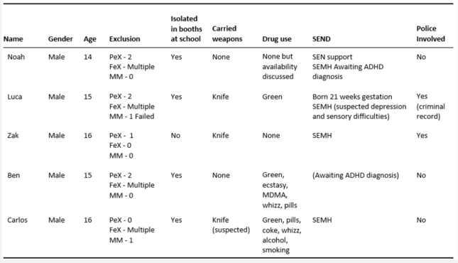
Theographs⁵
Five children
• Drivers, supply and implications of drug use
• Drivers and implications of carrying a knife
• Solutions to reducing fixed-period and permanent exclusion

Slide 25
Year | Overview
Y7 | Death of aunt, grief, anger, unable to cope with shouting
Y7 | Change of leadership, zero tolerance, isolation (bridge)
Y9 | Knife to make bong PeX, drug curiosity
Y10 | School 2, transition from AP too many points, failed
Y10 | School 3, 10 points only allowed 6, failed. Banter over a girl and phone in class
Y10-11 | Drug awareness, AP, engaging
'In my year there has been 6 people permanently excluded. They all got excluded when they started taking drugs. Their behaviour changed'

Slide 26
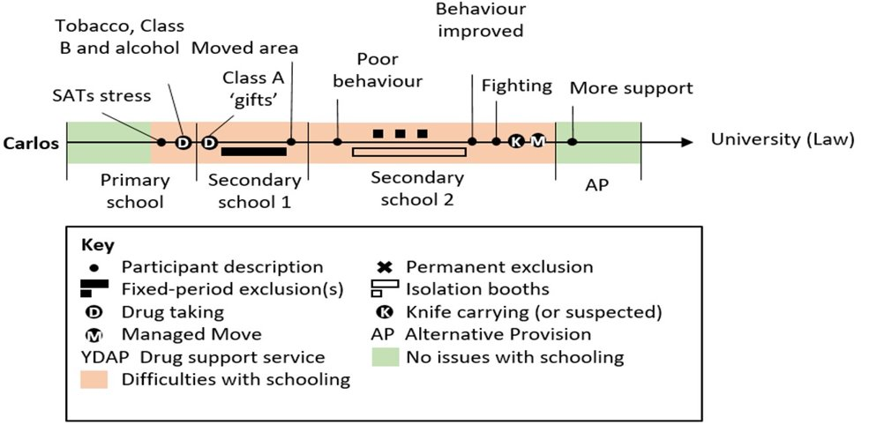
Year​ | Overview​
Y6 | SATS stress, academic focus​, smoking, weed, alcohol, drugs because older kids take them (Y10s-11s)
Y7 ​ | Unable to cope with teachers shouting, isolation, not taught
Y8-Y10 | Frequent isolation, no learning
Y10 | Accused of having a knife (never found)
Y10​ | School 3, 10 points only allowed 6, failed. Banter over a girl and phone in class​
Y10-11​ | Drug awareness, AP, engaging​
‘Younger people would get involved because the older people were taking it. The younger people would start hanging around with them and then they would take it. That happened to me. I was in Year 7 and I was messing up. So, I was ‘cool’, so I started hanging around with Year 10s and 11s. That was how I got into it and that is how most people get into it’.

Slide 27
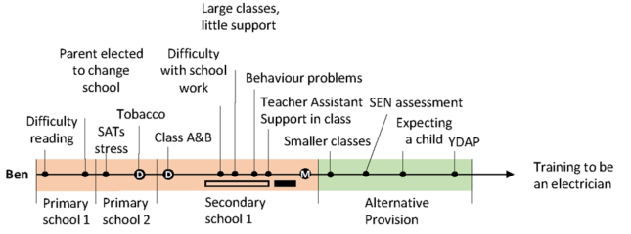
Year​ | Overview​
Y-5-6 | Taken out of class, unable to read, SATS stress
Y7- 11 | Unable to access curriculum, unidentified SEN
Y7-10 | Frequently in isolation
Y9 | Support for behaviour
Y11 | Becoming a father, came of drugs, focused on exam success, engaging in AP
I got took out class to do my work. Because I couldn’t read (y6).
They got this lass in to help with my behaviour. Why give me that in Year 9? Or Year 8? When I needed it in Year 7.

Slide 28
Drivers for drug use^{5,6}
Children are consuming drugs mainly to aid concentration in school, to self-medicate to reduce sanctions imposed on them by teachers⁵ and to relax^{5,6}
School curriculum pressures, too much focus on attainment at the cost of mental health^{5,6}
Lack of both early and prompt identification and support for children with SEND/SEMH from schools and complex referral processes^{5,6}
Further research needed on school exclusion and drug use

Slide 29
Implications of drug use^{2,3,4,6}
School exclusion, challenging behaviours in schools^{2,3,6}
Long term physical health conditions⁶
Long term mental health needs^{2,3,6}
Strain on family unit, caregivers unable to work^{3,4,6}
Criminal activity⁶
Detrimental effect on siblings⁶

Slide 30
What can be done to reduce drug use in CYP?
Early identification and assessment of learning of SEND, recognising indicators of substance to prevent disrupted pathways^{1,2,3,4,5,6}
Remove zero tolerance approaches in schools for drugs and weapons, instead listen and talk to identify causes^{2,5,6}
Where a child in a family is using drugs the siblings need to also have targeted support as they are currently overlooked⁶
Increase funding for schools to fund mental health support internally, exemption criteria in health services is preventative^{2,6}
Zero approach to behaviour creates a school environment where discretion is not shown, and underlying needs are not understood. Adolescents react to minor infractions by re-establishing their autonomy in defiant behaviour^{1,2,3}

Slide 31
How can schools best manage the transition from early years to school and minimise any negative effects on children, especially those from disadvantaged backgrounds? Theographs: A focus on autism

Slide 32
The road to school exclusion: An IPA of interviews with parents of children with autism⁹
Of the twenty-one caregivers who took part in the original study, five met the criteria for this article:
They had a child with a diagnosis of autism
They had a child who had received fixed-period and/or permanent exclusions

Slide 33
Justice
1 | Support from multiple health consultants for physical disabilities | 12 | Caregiver offers to home school child, mother working with LA to find a school place
2 | GP refers child to SaLT | 13 | Child added to waiting list for autism specific school provision
3 | Caregivers share developmental concerns with school | 14 | Caregivers request funding support for 1:1 tuition
4 | Mother carries out independent research into how to support daughter | 15 | School rejects request - insufficient funds
5 | Mother volunteers at special school to learn more | 16 | School provides TA support as an alternative
6 | School takes decision to retain child in reception for a second year | 17 | School suggests half day attendance, parents decline
7 | LA educational psychologist assessment, recommends transferral to a specialist unit | 18 | School imposes illegal fixed-period exclusions
8 | Caregivers decline specialist placement, feels the school does not want child | 19 | Mother buys more educational toys to support development at home
9 | Paediatrician diagnoses autism spectrum disorder, recommends mainstream with support | 20 | Caregivers share concern with school that child is regressing
10 | School recommends alternative school, caregivers refuse, school not for children with autism | 21 | Caregivers request dual placement for child
11 | School pressure parents to take place citing concerns over upcoming Ofsted inspection

Slide 34
Lucy
1 | School report behaviour concerns to mother | 13 | Child moved to back of class
2 | Child diagnosed with autism spectrum disorder | 14 | Multiple fixed-period exclusions
3 | Referred to CAMHS, CAMHS refer to CYPS | 15 | Mother requested school seek external support
4 | CAMHS refer to CYPS | 16 | School decline request
5 | CYPS reject referral | 17 | Mother contacts Autism Outreach
6 | Mother request transition meeting with School 2 (juniors) | 18 | Mother feels school does not want child
7 | Junior school reject request for transition meetings | 19 | Pupil assaults another child
8 | School change child's class the day before term starts | 20 | Permanent exclusion
9 | Child starts school 2 | 21 | Mother home schooling, considers tribunal case
10 | No SEN school support in place | 22 | Child starts school 3
11 | First fixed-period exclusion | 23 | Child participating and learning
12 | School tell parent child is difficult to manage

Slide 35
Olwen
1 | Accessed CAMHS who referred to CYPS who referred back to CAMHS | 16 | Multiple fixed-period exclusions
2 | Teacher reports being hit by child | 17 | Caregivers withdraw child from School 1
3 | Multiple fixed-period exclusions | 18 | Child diagnosed with ASD, ADHD and ODD
4 | Caregivers request referral for EHCP assessment by school | 19 | Multiple fixed-period exclusions
5 | School refuse EHCP assessment request | 20 | Parent returns to GP multiple times due to school exclusions
6 | School unable to needs, segregates child at breaktimes, parents complain | 21 | GP Referral to CAMHS
7 | Mother becomes anxious school will ring about child's behaviour | 22 | CAMHS refer to CYPS
8 | School attributes behaviour to home life and parenting | 23 | Caregivers feels school does not want child
9 | Early Help carry out home visit | 24 | Child school refuser, caregivers withdraws child from school
10 | Early Help unable to support | 25 | Child starts school 3
11 | School describe child as 'naughty' won't allow sensory breaks | 26 | Mother seeks external agency support which secures LA involvement
12 | Mother told to attend parenting course by school | 27 | Local Authority provide a PRU place
13 | Child Starts school 2 | 28 | CYPS give mental health support to child, external agency support parent
14 | CAMHS access resumed | 29 | Child formally withdrawn from mainstream schooling to attend a PRU
15 | CAMHS discharge - no issues | 30 | EHC Plan secured

Slide 36
Viv
1 | Parent requests SaLT referral | 13 | Child discloses suicidal feelings to caregivers | 25 | Child placed on school report | 37 | School declines EHCP Assessment request
2 | SaLT Finds no concerns | 14 | Caregivers tell child about ASD diagnosis | 26 | Multiple fixed-period exclusions | 38 | School move
3 | School reports disruptive behaviour to parent | 15 | Child assaults a pupil in school | 27 | Child physically assaulted by another child, resulting in dislocated finger | 39 | Child bullied for being different
4 | Parent requests consultant referral, consultant, no concerns | 16 | First fixed-period exclusion | 28 | Mother reports incident to school, dismissed as accident | 40 | Mother requested managed move, managed move agreed to PRU
5 | Consultant discharges with no concerns | 17 | School refers child to CAHMS | 29 | Caregivers contact police about disability discrimination | 41 | School move to PRU
6 | Mother arranges referral to consultant, child diagnosed with ASD | 18 | Multiple fixed-period exclusions | 30 | Police interviews result in no further action | 42 | Bespoke curriculum implemented, vocational college training agreed
7 | Caregivers request assessment for an EHCP | 19 | Multiple fixed-period exclusions | 31 | Mother requested a managed move/EHCP assessment by school | 43 | Child passing exams
8 | School decline caregiver request for EHCP | 20 | CAMHS suspect ADHD and refer to CYPS | 32 | School declines Managed Move and EHCP needs assessment | 44 | School 3 submits EHC assessment request
9 | Educational psychologist assessment arranged by school | 21 | Mutiple fixed-period exclusions | 33 | Mother prescribed beta blockers for anxiety | 45 | EHCP needs assessment rejected
10 | Educational psychologist finds no learning difficulties | 22 | CYPS diagnose ADHD, child medicated for ADHD | 34 | Child assaults pupil | 46 | EHCP assessment refusal appealed, school 3 provide supporting evidence
11 | SENCO requests assessment for EHCP | 23 | Caregivers report bullying to school | 35 | Permanent school exclusion | 47 | EHCP assessment decision overturned, EHCP granted
12 | LA decline assessment for EHCP | 24 | School removes breaktimes but re-instates after parental complaint | 36 | Caregivers re-request referral for EHCP assessment by school

Slide 37
Local recommendations (31)
Increase vocational pathways
Training on inclusive and exclusive practices
Further training in education on SEMH, ASD, SpLD and MLD including legal duties (Equality Act, 2010)
Health services assessments for children on the edge of or with exclusions
Expand alternative provision to allow for longer placements where appropriate
Key recommendations from children
‘Remove isolation booths from school as they do not work and they do not improve behaviour but make it worse’
‘We need smaller classes in school, 30 in a class is too noisy’

Slide 38
National recommendations (8)
Department of Education (DfE) to take steps to address the use of isolation booths through review of behaviour guidance
DfE to review exclusions guidance to change terminology to oblige schools to address underlying causes of disruptive behaviour
DfE to delegate more powers to LAs to enable them to hold schools to account for decision to exclude
Review of category ‘other’ as a reason for school exclusion
To create a national system of recording managed moves
To rename PRUs and Alternative Provision as ‘schools’
National guidance needed on category of Moderate Learning Difficulties and whether this should be re-categorised ‘learning disability’ with health assessments

Slide 39
Policy review: DfE (2016) Behaviour and discipline in schools
18. They should also consider whether continuing disruptive behaviour might be the result of unmet educational or other needs. At this point, the school should consider whether a multiagency assessment is necessary
42. Schools can adopt a policy which allows disruptive pupils to be placed in an area away from other pupils for a limited period
43. It is for individual schools to decide how long a pupil should be kept in seclusion or isolation, and for the staff member in charge to determine what pupils may and may not do during the time they are there. Schools should ensure that pupils are kept in seclusion or isolation no longer than is necessary and that their time spent there is used as constructively as possible.

Slide 40
Exclusion from maintained schools, academies and pupil referral units in England (DfE, 2017)
2. Key points
Disruptive behaviour can be an indication of unmet needs. Where a school has concerns about a pupil’s behaviour, it should try to identify causal factors and intervene early in order to reduce the need for a subsequent exclusion. Schools should consider whether a multi-agency assessment that goes beyond the pupil’s educational needs is required.
19. Early intervention to address underlying causes of disruptive behaviour should include an assessment of whether appropriate provision is in place to support any SEN or disability that a pupil may have. The head teacher should also consider the use of a multi-agency assessment for a pupil who demonstrates persistent disruptive behaviour. Such assessments may pick up unidentified SEN but the scope of the assessment could go further, for example, by seeking to identify mental health or family problems

Slide 41
Key messages.
Behaviour sanctions in mainstream schools such as detention and isolation booths do not improve behaviour but make it worse
Too many caregivers are told they would not meet the threshold for an EHC needs assessment
Schools are taking advantage of the loose terminology in statutory guidance
Children are consuming drugs before school to cope with their inability to access the learning, to aid their concentration and to medicate themselves to reduce the likelihood of being sanctioned by teachers
Prompt identification and support for children is important to support learning and subsequent mental health needs

Slide 42
Agenda item 4 Q and A

Slide 43
Agenda item 5 Roundtable discussion of potential of research influence on policy and gaps in evidence base

Slide 44
Agenda item 6 QR funding and future planned publications

Slide 45
Next steps
Next publications (58 headteachers)
QR Research Strategic Priorities Fund
Benefits of school exclusion
Alternatives to school exclusion
Most likely to be excluded
Reason for rise in SEMH
Solutions to SEMH
Pressures on HT next 5 years
Barriers to support SEMH
BACD bid to full application
Exclusions research needs extending to national sample
Drivers for drug use in excluded children population
Research highlights for schools, evidence based approaches

Slide 46
Agenda item 7 Future actions and ways forward

